Slide 1


Slide 2
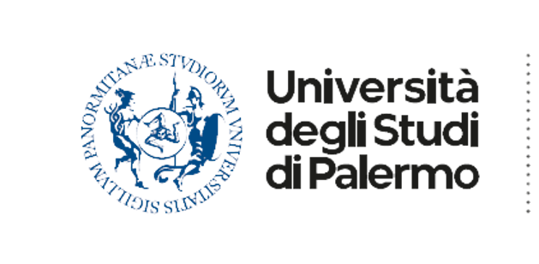






Settore Monitoraggio, analisi e sviluppo dei servizi bibliotecari e di reference digitale
del Sistema bibliotecario Unipa
Segreteria tecnica Unipa Springer: unipaspringer@unipa.it

Slide 3
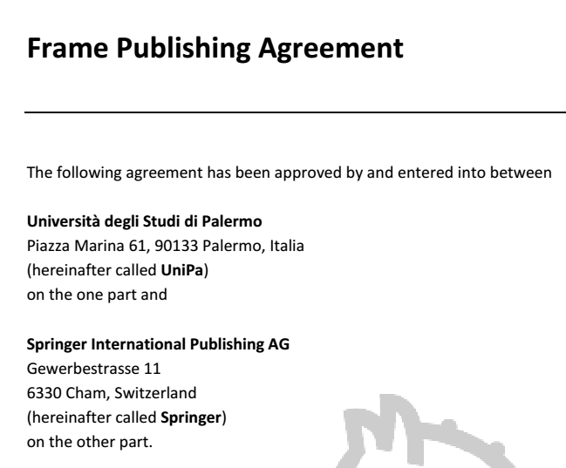
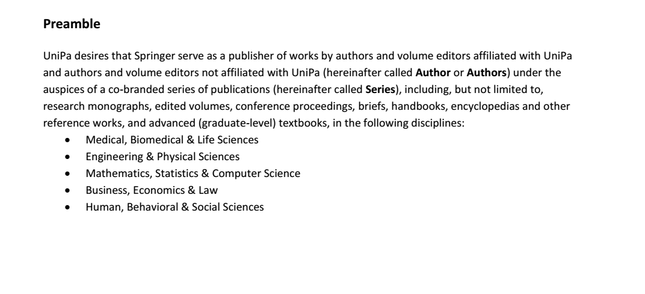

2013-2018
August 2013: The University of Palermo and the international publisher Springer sign an agreement for a joint Unipa Springer branded initiative.
October 2014: Unipa Springer Series technical secretariat is assigned to the Digital Library Sector of Unipa Library System. Work begins to support the first Editorial Committee with
Prof. Amenta Editor-in-Chief.
https://www.unipa.it/strutture/springer/

Slide 4
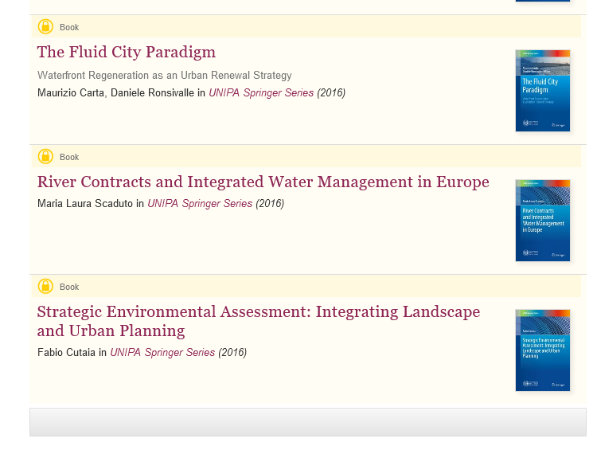
2016:
the first 3 volumes of the series are released
June 2017:
the agreement is renewed (without changes)
July 2017:
Following the reorganisation of the University's Central Administration and the redefinition of the structure of the University Library System,
Unipa Springer technical secretariat is assigned to «Monitoring, analysis and development Sector for library and digital reference services”
https://www.unipa.it/strutture/springer/

Slide 5

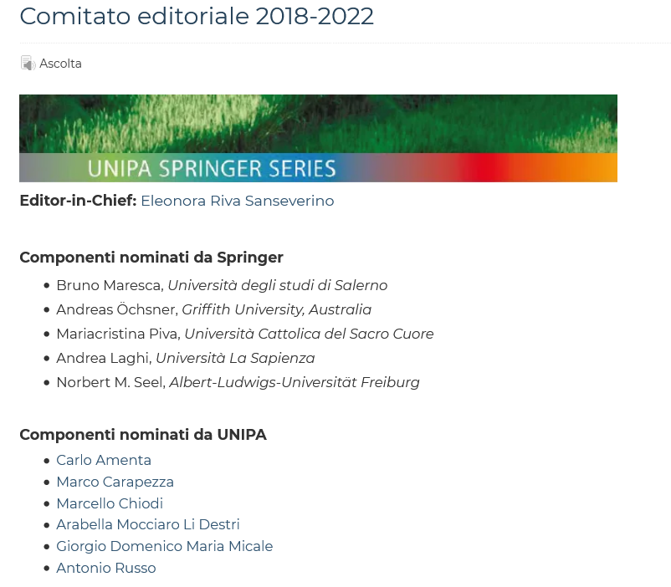
2018: The second Editorial Board with the new Editor-in-chief Prof. Eleonora Riva Sanseverino
2020: in view of the growth in activities and the commitment of the new Editorial Board to make Unipa Springer Series an interesting showcases of Unipa capacity for international research dissemination, the Editorial Board requested the DG to strengthen the Technical Secretariat
https://www.unipa.it/strutture/springer/

Slide 6
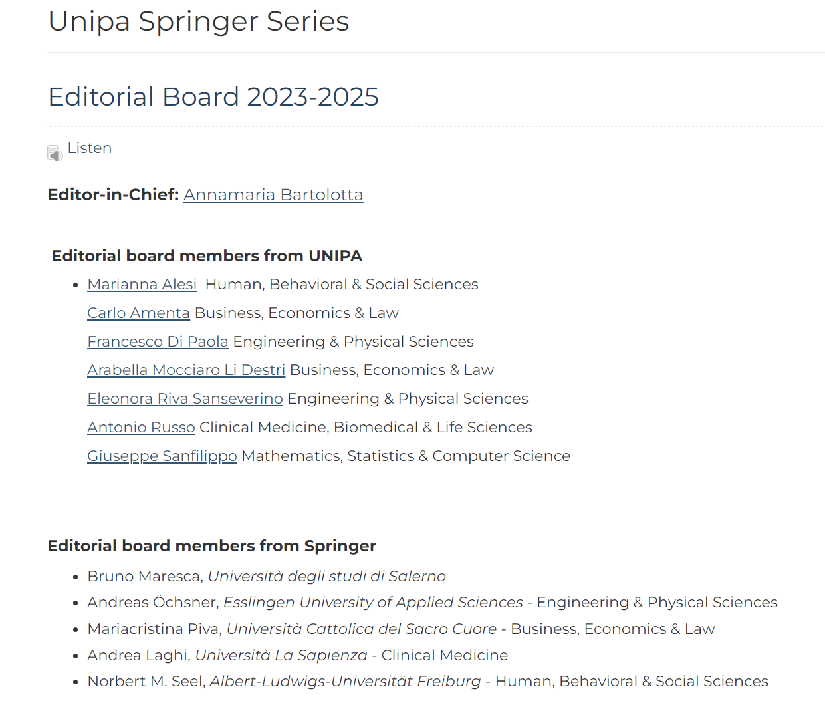
Jan. 2023
The current Editorial Board takes office. The Rector appoints
Prof. Anna Maria Bartolotta as the new Editor in Chief .
https://www.unipa.it/strutture/springer/

Slide 7
Unipa Springer «facts and figures» https://www.springer.com/series/13175
2013-2023
28 published titles in the series – 66 proposals
Jan. 2020 to Feb. 2024
- 23 new proposals sent to peer review
- 16 published titles
- 3 to be released in 2024

Slide 8
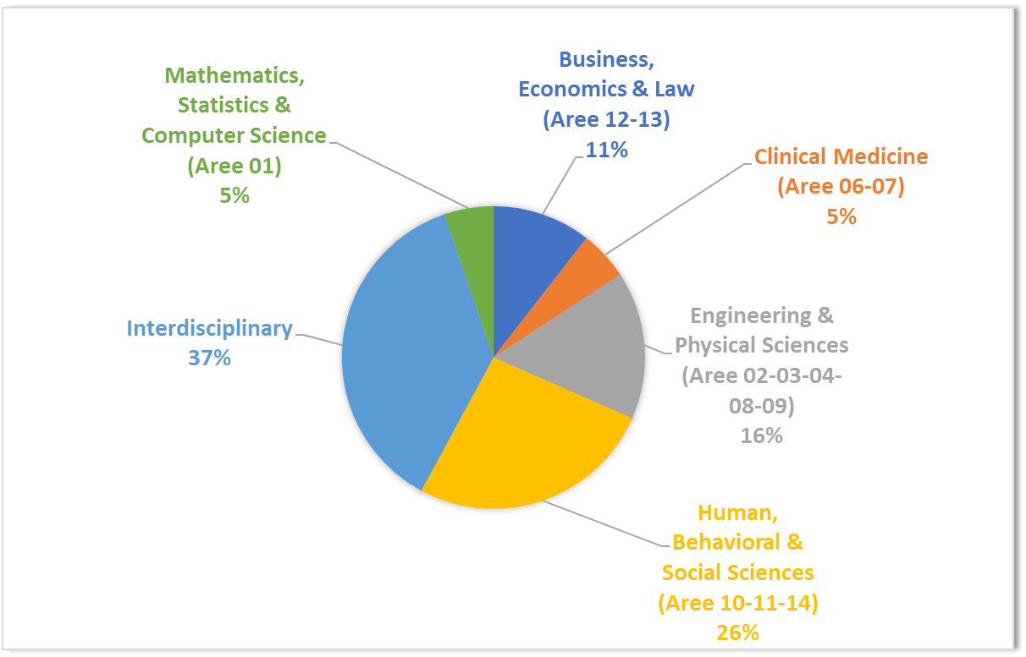
Unipa Springer «facts and figures»
2020- Jan. 2024 – disciplinary area of published titles

Slide 9
Unipa Springer «facts and figures»
2020-2023 proposals and titles published

Slide 10
Unipa Springer Series:
a chance for development (1/2)
The Series features prominent authors with works of scientific and educational relevance that have attracted much interest, as documented by the thousands of downloads and accesses.
Unipa Springer initiative can also be seen as an opportunity both for our younger authors and for researchers in disciplinary areas that need to enter the international circuit more strongly, such as those in the humanities.
Publishing with this international publisher may have a positive impact on the authors' careers and on the university as a whole: just think of the evaluation exercises (VQR, ASN, etc.)
The Series may also represent an opportunity for reviewers: peer review in an international context will be increasingly strategic, it allows our Unipa professors and researchers to confront with colleagues from other countries, it allows especially the younger ones to develop even more refined methodologies and skills.

Slide 11
Unipa Springer Series:
a chance for development (2/2)
The support activities for the Editorial Committee also proved to be a training ground for Unipa librarians.
Unipa librarians offer innovative librarianship skills (developed in the many services of the Library System, e.g. Information Literacy training activities also in an e-learning platform, digital reference via chat, Gdl Institutional Repository and OA, management of the University Digital Library) which could prove useful in the event Unipa will equip itself with new tools for publishing and disseminating research, including Open Access in an Open Science framework.
Unipa librarians by profession have a clear understanding of the dynamics and useful tools to support our authors on several fronts, with activities related to the new publication models.

Slide 12
Le attività della Segreteria tecnica unipaspringer@unipa.it
Gestione delle proposte editoriali
Assistenza personalizzata agli autori e ai revisori nelle diverse fasi del processo
Gestione della documentazione legata all’iniziativa
Monitoraggio del progresso delle submission verso tutte le fasi successive
Gestione della casella e-mail dedicata
Gestione delle pagine web dedicate nel portale UNIPA
Promozione e comunicazione dell’iniziativa in raccordo con gli uffici del Settore comunicazione dell’Ateneo (news, post sui social, etc.)
Partecipazione all’organizzazione di riunioni, seminari, attività formative
Svolgimento di incontri programmati con E-I-C per la condivisione di strategie organizzative
Individuazione di criticità e proposte di miglioramento
Raccordo con le diverse componenti del Sistema bibliotecario e Archivio storico di Ateneo e più in generale di UNIPA
Gestione del Team e del Drive dedicati

Slide 13


Technical Secretariat
UNIPA Springer Series
Patrizia Devescovi
Rosa Angela Anzalone
unipaspringer@unipa.it

