Slide 1
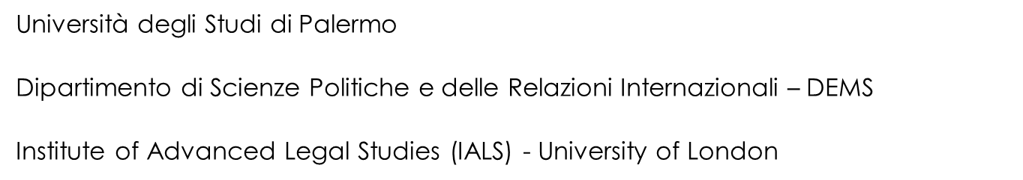




Languages matter!
The UNESCO report on the multilingualism's role in research and education
Giulia Adriana Pennisi
The Role of Languages in Scientific Research from an International Perspective
CLA – University of Palermo 26 February 2026

Slide 2
scienza vs lingue straniere
la conoscenza di altre lingue straniere
crea collaborazioni internazionali
amplia le opportunità di ricerca
consente la comprensione delle pubblicazioni scientifiche in altre lingue
arricchisce il percorso professionale nella ricerca
la scienza è universale
la comunicazione delle scoperte scientifiche passa attraverso il filtro delle lingue
l’inglese è considerato la lingua franca della scienza moderna

Slide 3

Language is a ‘human right’
“… linguists have shown that language isn’t just about words and grammar —it’s about how we construct meaning, how we learn, and how we engage with the world.
And that brings me to a crucial point: language is also a human right.
The Universal Declaration of Linguistic Rights, adopted in Barcelona in 1996, upholds the right to use one’s own language without discrimination. Ensuring linguistic rights is about giving people the freedom to use and learn their languages and to reaffirm their own identity, dignity and participation in society. …”.
Stefania Giannini - UNESCO Assistant Director-General for Education
the Silver Jubilee Celebration of International Mother Language Day 2025 held at UNESCO Headquarters in Paris on 21 February 2025
https://www.unesco.org/en/articles/language-matters-role-and-power-multilingualism

Slide 4

Language as a lens for how we understand the world
Multilingualism is the ground to unlock its potential
Cognitively, it sharpens problem-solving, strengthens memory, and boosts adaptability. Neurological research confirms this.
Economically, multilingual workplaces perform better and drive innovation.
Socially, multilingualism fosters inclusion, belonging, and peace.
Stefania Giannini - UNESCO Assistant Director-General for Education
https://www.unesco.org/en/articles/language-matters-role-and-power-multilingualism

Slide 5
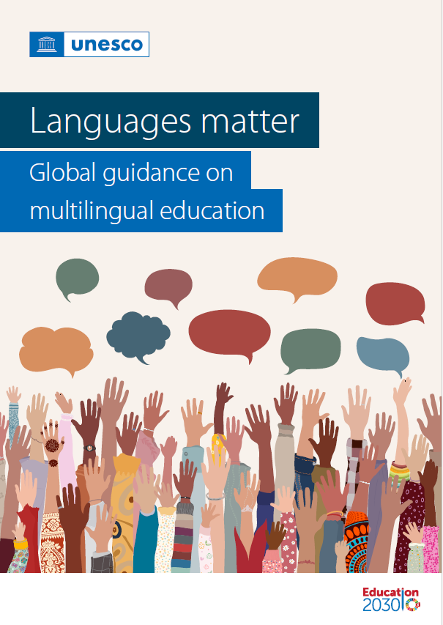
UNESCO
EDUCATION 2030
https://www.unesco.org/en/articles/language-matters-role-and-power-multilingualism

Slide 6
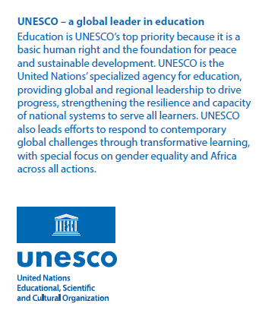
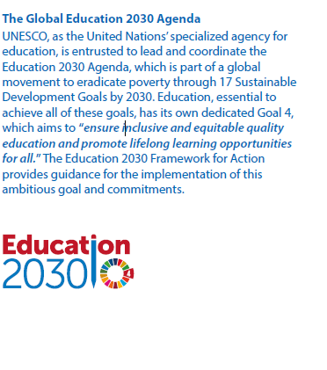
UNESCO and EDUCATION

Slide 7
UNESCO Report
Global guidance on multilingual education
Short summary
The linguistic landscape has significantly changed in recent years.
This evolution has been shaped by migration, technological developments, and growing recognition of multilingualism’s cognitive, social and economic benefits. This guide presents up-to-date principles for language-in-education policies that recognize multilingualism as both a fundamental human characteristic and an essential educational approach.
It supports Ministries of Education and their partners in integrating multilingual education into policy and practice, with the goal of improving learning outcomes, promoting inclusion, and safeguarding linguistic and cultural identities, knowledge, and practices.
UNESCO Report p. 3

Slide 8
Table of Content
Acronyms
Glossary
Executive summary
Key messages
Introduction
What multilingual education is
Why multilingual education matters
Practical actions for multilingual education
Conclusion
References

Slide 9
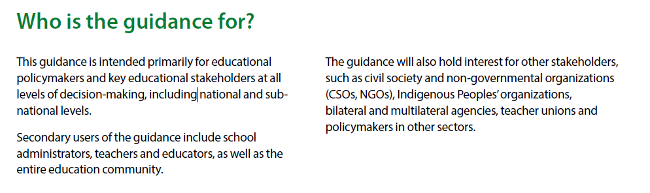
Introduction
UNESCO Report p. 18

Slide 10
What multilingual education is
UNESCO (2003a, p. 17) defined multilingual education (MLE) as
“the use of at least three languages, the mother tongue, a regional or national language, and an international language in education.”
However, an online search for “multilingual education” reveals many programmes, projects and approaches that do not align with UNESCO’s definition.
In some understandings, multilingual education is more about a mindset than a specific language count. As a result, some bilingual programmes are labelled multilingual, while others involve three languages but omit the learners’ first language (L1). In essence, the term has evolved to mean different things to different people.
UNESCO Report p. 24

Slide 11
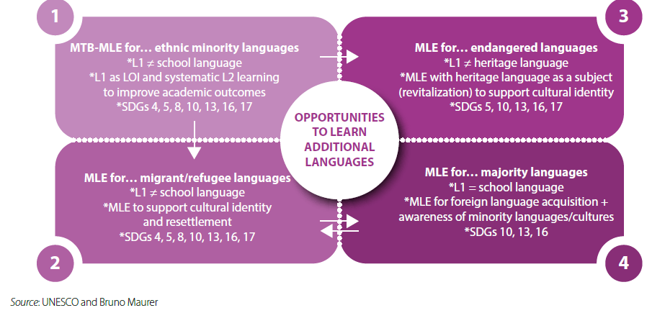
The four contexts of Multilingual Education (MLE)
UNESCO Report p. 24

Slide 12
The four contexts of Multilingual Education (MLE)
UNESCO Report p. 52
UNESCO Report p. 24

Slide 13
Context 4: MLE for majority languages
MLE means:
The use of two or more languages in education, which may or may include the mother tongue. When the mother tongue is the primary language of instruction, it is called mother tongue-based multilingual education. Multilingual education can include bilingual education.
Context 4
the learners’ L1 generally corresponds to the official language in their country, typically the majority language.
Policymakers and parents, however, often recognize the importance of developing proficiency in the official languages of other countries to enhance opportunities for mobility, tertiary education and career advancement.
Many education systems seek to go beyond offering foreign language classes by using those languages as languages of instruction (LOIs) to teach subjects like math or science. This approach is commonly known as Content and Language Integrated Learning (CLIL) or similar classifications. Reference to MLE in Europe and international schools elsewhere generally refer to Context 4 situations. In North America, dual language and two-way bilingual programme also fall into Context 4.
UNESCO report p. 27

Slide 14
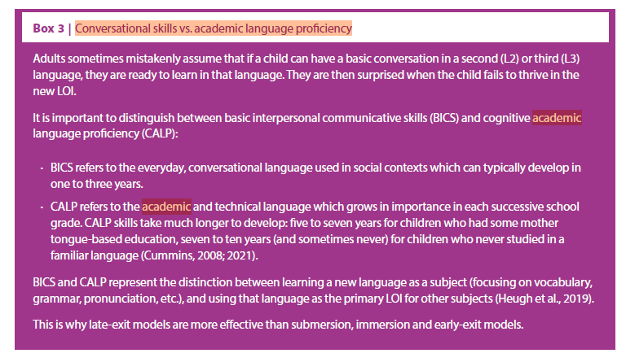
BICS vs CALP / LOI
UNESCO Report p. 29

Slide 15
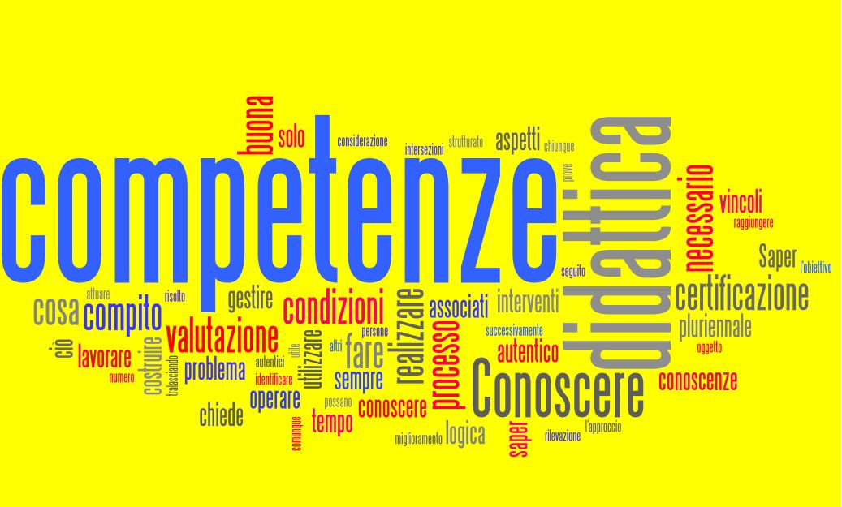
Using a new language as the primary LOI for other subjects

Slide 16
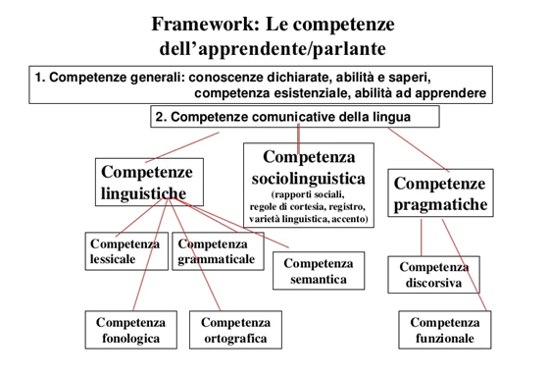
Competenze comunicative

Slide 17
Fostering economic growth and innovation
MLE also fosters economic growth and innovation by nurturing creativity, enhancing problem-solving abilities and improving educational outcomes among marginalized populations. Research shows that educational approaches that embrace multilingualism can spark greater creativity and equip learners with the skills needed to tackle complex challenges (Fürst and Grin, 2021).
MLE encourages learners to think flexibly and adapt to new environments, boosting their academic performance and enhancing their ability to innovate in diverse contexts (World Bank, 2018).
These cognitive benefits are particularly valuable in today’s globalized economy, where adaptability and creative problem-solving are essential for driving innovation.
UNESCO Report p. 52

Slide 18
The case of Switzerland
MLE also facilitates social and economic mobility by improving job access and increasing economic participation. For example, Switzerland attributes 10% of its gross domestic product (GDP) to its multilingual heritage, which includes French, German, Italian and Romansh, while the United Kingdom of Great Britain and Northern Ireland has been estimated to lose approximately 3.5% of its GDP annually due to relatively poor language skills among its population (Hardach, 2018).
In South Africa, an increase in mother tongue-based education from four to six years corresponded to a rise in wages, highlighting the economic benefits of MLE (Eriksson, 2014).
Countries that promote multilingualism experience significant benefits, including increased export success and a more innovative workforce (Hardach, 2018; Fürst and Grin, 2021).
UNESCO Report p. 52

Slide 19
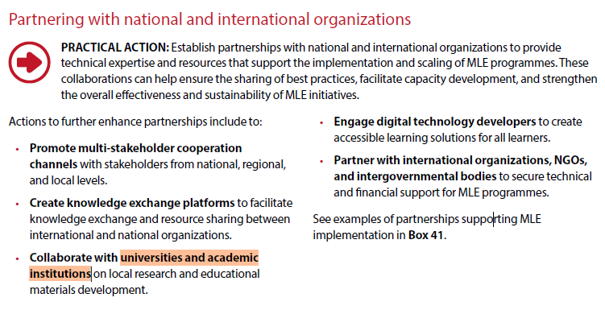
Universities and academic institutions
UNESCO Report p. 89

Slide 20

Prospettive future → AI
lavorare sulle modalità di insegnamento e apprendimento delle lingue che integrino discipline accademiche e il mondo delle professioni
con particolare attenzione allo sviluppo delle capacità comunicative
con specifiche modalità di
applicazioni pratiche in contesti professionali
Il Ruolo dell’IA nell’Apprendimento delle Lingue | BiblioLingua
Progetto Cofinanziato dall’UE

Slide 21
References
Bhatia V.K. 2008, Towards Critical Genre Analysis, in Bhatia V.K., Flowerdew J. and Jones R.H. (eds.), Advances in Discourse Studies, Routledge, London / New York,pp. 166-177.
Fairclough, N. 2012. Critical Discourse Analysis. In Gee J. and Handford M. (eds.), The Routledge Handbook of Discourse Analysis, Routledge, London, pp. 9–20.
Flowerdew J. and Richardson John E. 2018. The Routledge Handbook of Critical Discourse Studies. London and New York: Routledge.
Halliday M.A.K. and Matthiessen C.M.I.M. 2013. Introduction to Functional Grammar. Routledge: London / New York.
Hyland, K. 2022. “English for Specific Purposes: What Is It and Where Is It Taking Us?”. ESP Today 10(2), pp.202-220.
Xiaoning, L. 2023. “Application of Interdisciplinary Thinking in English Teaching”. Scientific Journal Of Humanities and Social Sciences Volume 5(9), pp.1-7.
Zanola, A. 2023. La Lingua Inglese per la Comunicazione Scientifica e Professionale. Carrocci editore, Roma.

Slide 22
Languages matter!
The UNESCO report on the multilingualism's role in research and education
Giulia Adriana Pennisi
Thank you!

