Slide 1
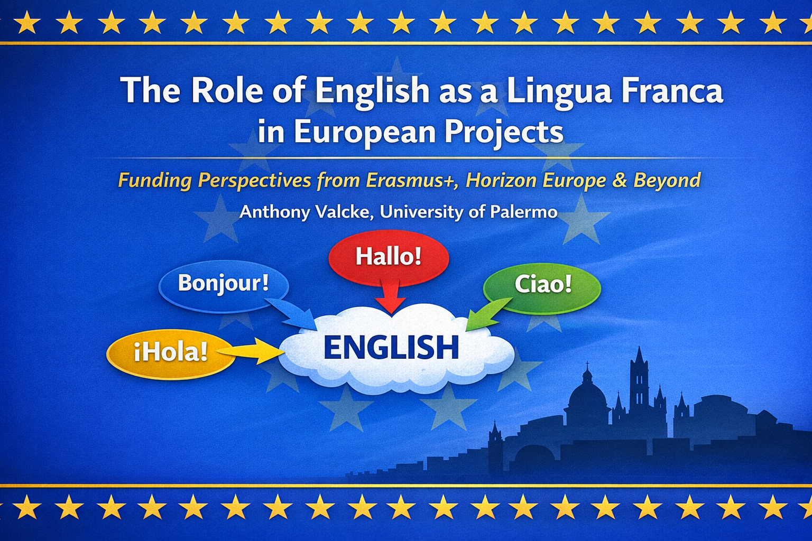

Slide 2
Meaning of English as Lingua Franca
Vehicular language for non-native speakers in multilingual settings.
Dominance in EU science: 80%+ research papers in English
EU context: Bridges 24 official languages + 60 minority ones

Slide 3
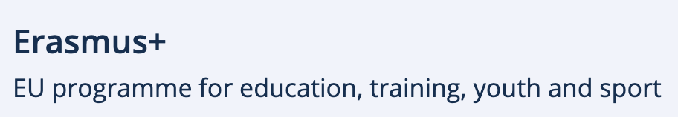


EU Funding Overview
Program | Budget (2021-2027) | ELF Focus
 | €26bn | KA1 mobility, KA2 partnerships, JM actions
Horizon Europe | €95.5bn | R&I proposals, consortia
Others (Digital Europe) | €7.5bn | Language tech innovation

Slide 4
KA1 mobility: Language requirements: B1-B2 English for participants; Online language support in 24 official EU languages
KA2: Funds strategic partnerships (e.g., multilingual glossaries via English coordination)
Jean Monnet actions: English is often used as the primary working language for the submission

Slide 5
Proposals: English only - no translations accepted.
Consortia: 10+ nationalities; ELF standardizes evaluations.
Funding multilingualism: €2m+ for language tech & Social Sciences and Humanities integration

Slide 6
AI tools for real-time multilingualism via English base infrastructure

Slide 7
Use of English to promote multilingualism?
Example:
Ready Study Go Around Europe! project—English as hub for 8-language vocational training resources (EE, FI, HU, IT, PL, ES, SE & TÜ) (Leonardo da Vinci EU project, now vocational education and training under Erasmus+)

Slide 8
Challenges and benefits
Challenges | Benefits
Non-native barriers; equity gaps | Efficiency; open access
Linguistic imperialism fears | project success lift? mobility boost

Slide 9
Key takeaways
ELF is indispensable for EU project proposals
ELF is equally indispensable for dissemination of project results
Foster international collaboration

Slide 10
Useful resources for project proposal writing
AI multilingualism tools: https://language-tools.ec.europa.eu/
Proposal writing toolkits
https://eufundingconsulting.eu/horizon-europe-strategic-language-toolkit/
How (not) to use AI in proposal writing
https://english.rvo.nl/topics/horizon-europe/how-use-ai-grant-proposal-writing

Slide 11
Academic discussion of ELF
Marko Modiano, ‘Identity and standards for English as a European Union lingua franca’ (2024) World Englishes, Sp. Issue on English in Europe, Vol 43(2), pp 210-227 https://onlinelibrary.wiley.com/doi/10.1111/weng.12646
Andrea Olivares-Beltrán and Teresa Morell, ‘The role of English as a Lingua Franca in European projects: The case of the RSGAE project’ (2017) EPiC Series in Language and Linguistics, Vol 2, pp 135–142 https://rua.ua.es/server/api/core/bitstreams/add9ee64-f4f9-43f2-8eae-8de62a298a53/content
Barbara Seidlhofer, Angelika Breiteneder and Marie-Luise Pitzl, ‘English as a Lingua Franca in Europe: Challenges for Applied Linguistics’ (2006) Annual Review of Applied Linguistics. Vol 26, pp 3-34 https://www.cambridge.org/core/journals/annual-review-of-applied-linguistics/article/abs/english-as-a-lingua-franca-in-europe-challenges-for-applied-linguistics/526EEA5A63799B5C023AFD896655E2B0

Slide 12
Any questions?

