Slide 1
University evaluation systems:
The experience of the University of Palermo
Antonella Plaia
Rector’s Delegate for the Evaluation
Antonella Plaia
Palermo April 10-11 2014

Slide 2
ENQA Standards and Guidelines for Quality Assurance in the European Higher Education Area
“Institutions should have a policy and associated procedures for the assurance of the quality and standards of their programmes and awards. They should also commit themselves explicitly to the development of a culture which recognises the importance of quality, and quality assurance, in their work. To achieve this, institutions should develop and implement a strategy for the continuous enhancement of quality.
The strategy, policy and procedures should have a formal status and be publicly available.
Formal policies and procedures provide a framework within which higher education institutions can develop and monitor the effectiveness of their quality assurance systems.
Institutions should ensure that they collect, analyse and use relevant information for the effective management of their programmes of study and other activities.”
Antonella Plaia
Palermo April 10-11 2014

Slide 3
Evaluation in UNIPA:1990-2000
Campus Project
Experimental project (without funding).
First experience (for UNIPA) of Self-Evaluation Report
Deming “Plan – Do – Check – Act”: iterative four-step management method used for the control and continuous improvement of processes and products
Peer Review
The Ministry of Education, using European Funds, funded 7 short degrees (diploma).
Not only financial reporting
The first experiments of performance evaluation: tracking the careers of students.
Since 2000 UNIPA has a delegate to evaluation activities, UNIPA declares its Mission, the Charter of Services is issued.
Antonella Plaia
Palermo April 10-11 2014

Slide 4
Evaluation in UNIPA:2001-2009
CampusOne Experience
CampusOne national project , a project funded by the government with the use of UMTS funds (Law 388 - 31.12.2000) and managed by the CRUI (Conference of Italian University Rectors ) .
The aim of the national project is to be able to provide the universities - in the three years 2001-2004 – with models and tools with which to implement, measure and improve the process of reform introduced by the DM 509/99 (the so called 3+2 reform of universities – bachelor + master).
The goal is to transfer to the new three-year degrees the standards applied to university degrees financed by Campus project.
Antonella Plaia
Palermo April 10-11 2014

Slide 5
Evaluation in UNIPA:2001-2009
CampusOne Experience
UNIPA participates with 5 programs, and, during the second year of the project, 9 new programs entered (but without funding), in order to experiment the main elements provided by the project: the teaching management , the stage activities and the evaluation.
The objective was achieved through the following specific actions :
• Educational Management (Educational tutors, 14 educational managers are now present in UNIPA)
• Certification of language and computer skills (start-up UNIPA Language Center)
• Stage and internships (start-up of Liaison Office and Stage and Internship Office)
• Evaluation (development of a culture of teaching evaluation)
• Relationship with the territory (involvement of stakeholders)
• Strengthening of ICT (Information and Communication Technology) services (start-up of UNIPA Museum network)
Antonella Plaia
Palermo April 10-11 2014

Slide 6
Evaluation in UNIPA:2001-2009
EUA experience
In 2008 UNIPA participates to the EUA’s Institutional Evaluation Programme (IEP).
IEP provides external institutional evaluation services to higher education institutions in the context of their own aims and profiles since 1994.
The evaluation begins with a self-evaluation process and a self-evaluation report conducted by the institution, followed by two site visits by an evaluation team, and is concluded with a final report by the evaluation team highlighting good practices identified and providing recommendations for improvement.
The focus of an IEP evaluation is the institution as a whole and not the individual study programmes or units. Recommendations and insights are provided on the institutions’ structures, processes, policies and culture, to enable them to perform the full range of their activities in line with their strategic plans and objectives, and build the capacity to address change processes.
Antonella Plaia
Palermo April 10-11 2014

Slide 7
Evaluation in UNIPA:2001-2009
EUA experience
The internal quality processes for which clear and defined responsibilities exist and
which appear to be more widely shared within the Institution are:
1. Teaching evaluation on the basis of student assessment (since 1999)
2. Research activity evaluation (since 2006)
3. Evaluation of the objectives of technical-administrative staff (since 2004)
UNIPA Actions after EUA report
82 departments: too many, now 20
12 faculties: too many, now 5 schools
Set out a Strategic Plan followed by a structured implementation plan with “mile-stones” and a monitoring procedure.
Students are now involved in many commissions and groups.
Measures have been taken to develop the graduates’ entrepreneurial skills (ARCA)
Antonella Plaia
Palermo April 10-11 2014

Slide 8
Evaluation in UNIPA:2010-
Since 2010 a competitive fund is distributed by Italian University Ministry to reward both teaching and research quality. The incidence of this competitive fund on the total amount of fund distributed increased since then.
Teaching evaluation
Teaching quality is evaluated according to 2 performance indicators, one that considers the amount of “regular-active” students and another based on the amount of credits earned by students.
Since 2010 UNIPA started to monitor these indicators at different levels:
University
Faculty
Single Program
The results of this monitoring process are shown to heads of faculties and programs every year, usually after the Ministry has assigned the competitive fund.
Antonella Plaia
Palermo April 10-11 2014

Slide 9
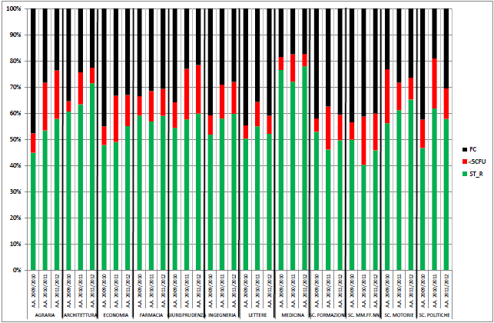
Antonella Plaia
Palermo April 10-11 2014

Slide 10
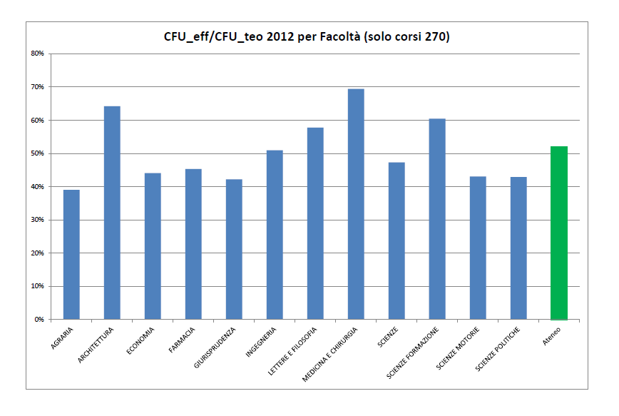
Antonella Plaia
Palermo April 10-11 2014

Slide 11
Research assesment (since 2006)
Research database where each professor/postdoc/phd student uploads his/her research products, research projects, …
14 research assessment commitees that evaluate, each year, UNIPA research.
The results of the evaluation process allow to join competitions for research funds, to join phd board, to become postdoc tutor.
Since 2010 a competitive fund is distributed by Italian Ministry of Education to reward both teaching and research quality. The incidence of this competitive fund on the total amount of fund distributed increased since then.
Antonella Plaia
Palermo April 10-11 2014

Slide 12
Results of the ANVUR VQR 2004-2010
VQR (Evaluation of Research Quality) is the Italian research assessment exercise that ANVUR (the National Agency for the Evaluation of the University and Research system) carried out on behalf of the Italian Ministry for Education.
We use VQR results to see how each department performed.
We have now aligned internal research assessment to VQR criteria.
Antonella Plaia
Palermo April 10-11 2014

Slide 13
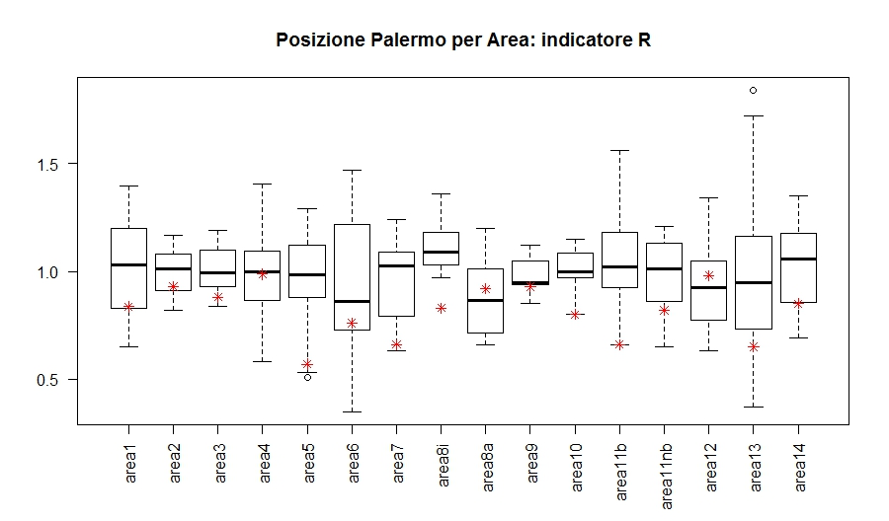
Average grade of expected research products with respect to average grade of the (research) area: R_{i,j}
Antonella Plaia
Palermo April 10-11 2014

Slide 16
Conclusions
“Institutional self-knowledge is the starting point for effective quality assurance.
It is important that institutions have the means of collecting and analysing information about their own activities.
Without this they will not know what is working well and what needs attention, or the results of innovatory practices.” ENQA Standards and Guidelines.
UNIPA tries to follow these recommendations since early nineties.
UNIPA tries to remain aligned with all the changes in the evaluation activities implemented by the Ministry and ANVUR, namely: indicators for the distribution of competitive fund, indicators for University Strategic plans, VQR, …
The main problem is sometime the rate (or the speed, actually really high) with which the Ministry changes the evaluation indicators.
Antonella Plaia
Palermo April 10-11 2014

