Slide 1


A SHORT PRESENTATION OF
UNIVERSITY OF PALERMO
AND
RESEARCH AND TECHNOLOGY TRANSFER AREA
Silvana Di Bono
Palermo, Italy

Slide 2
https://www.youtube.com/watch?v=jqMgDxrU8CA
Qui ad UniPa noi facciamo così [ShV - ENG - HD]

Slide 3
UNIPA IN FIGURES / Education and internationalization
Study courses in English | 10 international courses at Master and Bachelor levels 55 double-degree study courses 20 integrated study programmes > 420 English-taught courses
International students | 2022-2023 Incoming students> 600 2022-2023 Outgoing students>1.000
International agreements | more than 1.000 Erasmus agreements 200 Framework Agreements apart Erasmus
Educational offer (2022/2023) | 146 degree courses (first and second cycle) 40 master courses 34 specialization schools 31 PhD programmes

Slide 4
UNIPA IN FIGURES /Human and structural resources
Academic community (2022) | 43.000 students 1.583 lecturers and researchers 5.518 research contracts (132 fellowships, 984 PhDs and postdocs, 2.970 research grant holders, 1.432 students attending specialisation courses) 1.851 managers, technical & administrative staff units, language experts
Academic structures | 16 Departments - 1 School of Medicine 21 libraries 3 decentralised premises (Agrigento, Trapani, Caltanissetta) Museum System (SIMUA) University Library System and Historical Archive (SBA) Language Centre (CLA) Italian school for foreign students (ITASTRA) Guidance Centre (COT) Advanced Technologies Network Center (ATEN) University Business Incubator (ARCA) Centre for Sustainability & Environmental Transition

Slide 5
UNIPA IN FIGURES / Research
EU projects funded | 48 Horizon 2020 projects, overall amount € 15.700.00 14 Horizon Europe projects, overall amount € 2.700.000 41 projects funded within other EU programmes and joint initiatives (Ecsel, IMI2, SESAR, ERA-NET, JPI, PRIMA, 3HP, EU4Health, ISFP, JUST, REC, LIFE, RFCS, CEF, CERV, PRIMA, KDT JU, TRANSCAN), overall amount € 6.000.000 102 research projects of national relevance (PRIN 2015-2017-2020), overall amount € 11.500.000 26 territorial cooperation projects (Italy-Malta, INTERREG MED, Italy-Tunisia, ENI CBC MED), overall amount of € 9.000.000 2020-2023: 33 projects Erasmus+ KA1, KA2 Capacity Building and Strategic/Cooperation Partnerships, ERASMUS Mundus, Jean Monnet, European University Initiative 242 Structural Funds projects, overall amount € 156.000.000 21 projects funded under the National Recovery and Resilience Plan – Next Generation Europe, about € 130.000.000
Patents | 123
Spin-off | 31

Slide 6
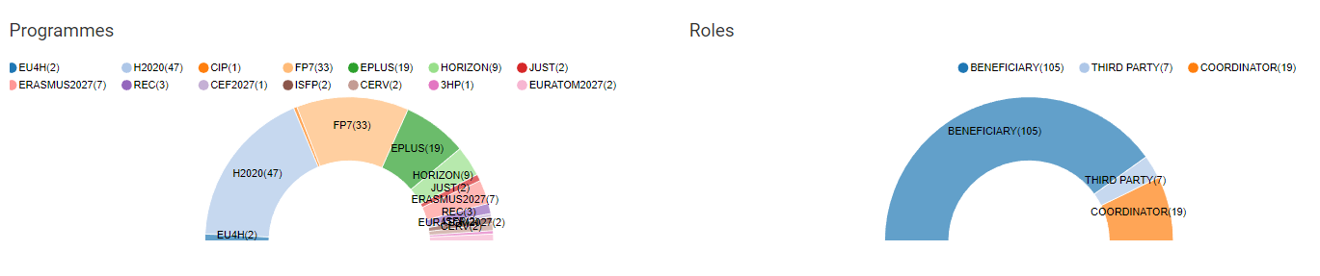

Slide 7
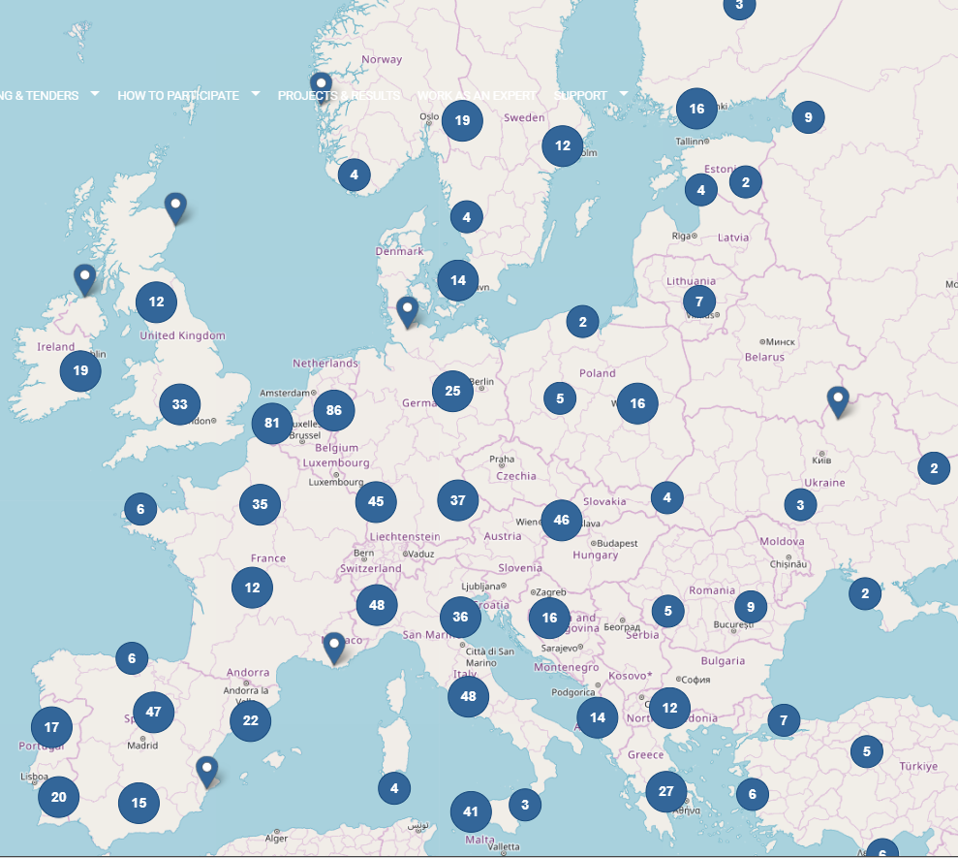
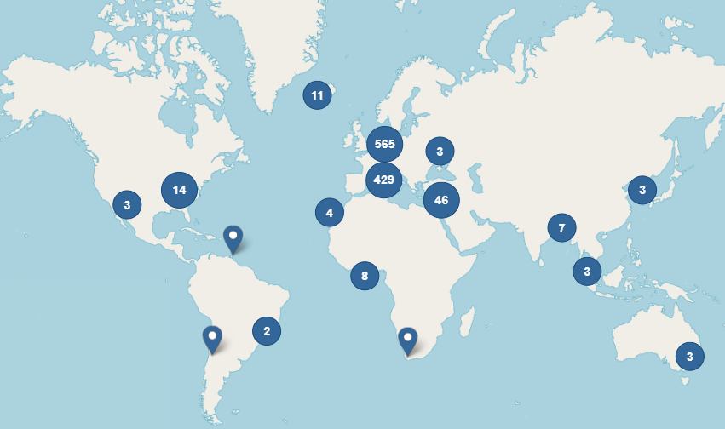
Main collaboration partners

Slide 8

‘To realize the future of Europe, to realize the Europe of the future, the Europe of young people, the Europe of research, it is necessary to adopt a system of rules for researchers and their employers that also takes into account ethical aspects and equal opportunities’
European Charter of Researchers and of Code of Conduct
It is a tool to affirm the founding values and principles and to adapt its development strategies to the needs of a changing society.
It leads the university into the EU network of research institutes, to achieve ecological and socio-economic sustainability goals.
It is a tool for monitoring the effectiveness of actions to protect freedom of research, free movement of 'knowledge’ and ideas.
It acts in defense of human rights, diversity, equity and inclusion in the workplace.
the OTM-R checklist
approval of the principles of the EU Charter for Researchers and the Code of Conduct for the Recruitment of Researchers
Internal gap analysis, self-evaluation, action plan, 'HR-Excellence in Research' award
the two-year internal evaluation was carried out and the initial action plan revised
1st external evaluation by EC experts and confirmation of award
updated version of the action plan including the OTM-R checklist
2008
2010
2012
2014
2017

Slide 9
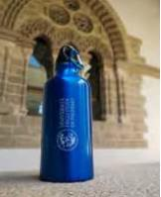

UNIPA is the first University in Italy to launch a Centre for Sustainability and Ecological
Transition, with a Scientific Board composed by professors experts the 17 sustainable
development goals (SDG). The SDGs have been defined in the Agenda 2030 of the UN and aim at changing the idea of sustainability towards an interdisciplinary approach, ranging from equal opportunities, to instructions, to consolidating democratic institutions.
A Regional Forum on Sustainability and Ecological Transition will tighten the cooperation between the University and the stakeholders working on themes connected to sustainability. The Centre will involve in such a forum also small and middle-sized companies to lead them towards innovative and sustainable patters, the assessment and reduction of the energetic and environmental impact connected to their production process, and eco-design, especially using already existing good practices.
UNIPA directly contributes to sustainability with approaches for energy consumption, supply chain, and mobility to minimize the environmental, social, and economic impact of the activities and with responsible choices towards decarbonization, as well as “Green Public Procurement” practices.

Slide 10
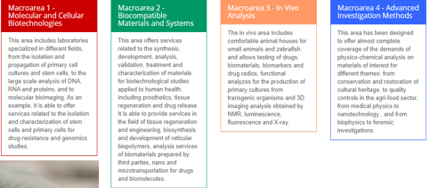
ATEN -Advanced Technologies Network Center, our network of University labs for testing and transferring new technologies to SMEs
one of the few R&D centers in Europe in the field of Biotechnology applied to human health
provides support for research, innovation and technological development activities in both the public and private sectors
In its laboratories, biologists, biotechnologists, chemists, physicists, engineers, doctors and informaticians work in synergy to generate and transfer new knowledge to competitive products for the national and international market.

Slide 11

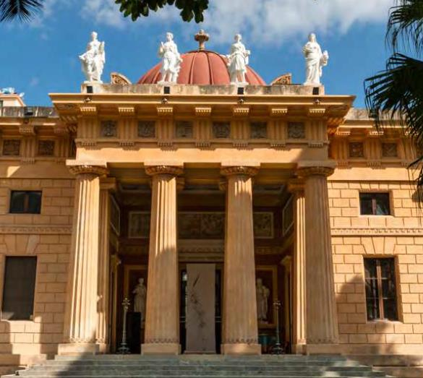
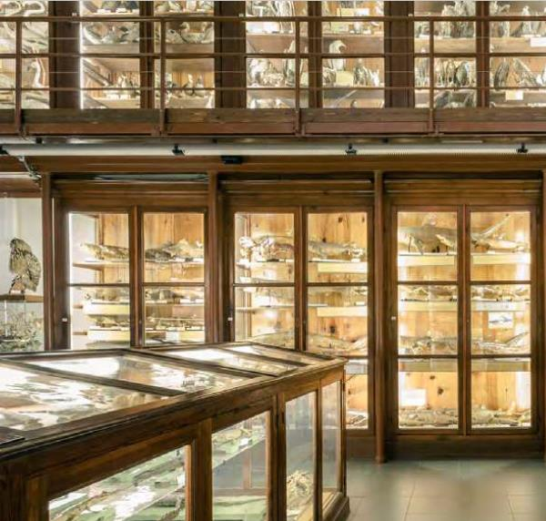
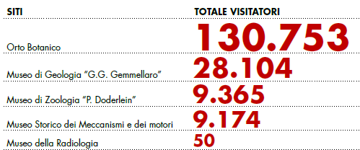
The University of Palermo preserves a rich highly valuable heritage of archaeological, historical, artistic and scientific interest. Its historical buildings of great value, chapels, paintings, museums and the botanical garden are regularly open to the public or can be visited on request.
The University of Palermo established in 2017 the Service Centre "Sistema Museale di Ateneo" (SiMuA) to improve the valorization of its cultural heritage.
SiMuA, housed inside the Botanical Garden, aims to exploit, preserve and enhance this great heritage, but above all to promote its most interesting and notable assets, contributing to spread knowledge about them
http://www.musei.unipa.it/eng/virtual.html

Slide 12
SBA - UNIVERSITY LIBRARY SYSTEM SERVICES
https://guidastudente.unipa.it/en/library-system/
https://www.unipa.it/biblioteche/en/scopri-i-servizi/supporto-alla-ricerca/index.html
support the academic community in the process of disseminating scientific products: intellectual responsibility, ethical and integrity aspects of research, choosing the editorial positioning of products, and editorial workflow, self-archiving of scientific research products and bibliometric implications
open access for disseminating scientific knowledge: awareness-raising of Open Access policies, services, obligations for national and European funding, safe publishing, reliable publishers and OA journals vs. predatory publishers and journals, main international bibliographic indexes listing OA resources; how to autonomously manage an OA journal; OA to research data; archiving/managing metadata
copyright laws, negotiating own rights to use the scientific works to be published, supported by a model of addendum to the publication contract and a “license to publish” model, information on publishers' policies, advice on specific databases to be used for self-archiving, compatible with copyright
research measurement: evaluation of the impact of scientific production for individual researchers as well as for research departments, use of bibliometric tools to maximize the impact of research, creation of the individual bibliometric profile of researchers in the citation databases

Slide 13
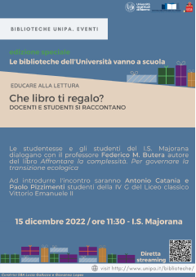
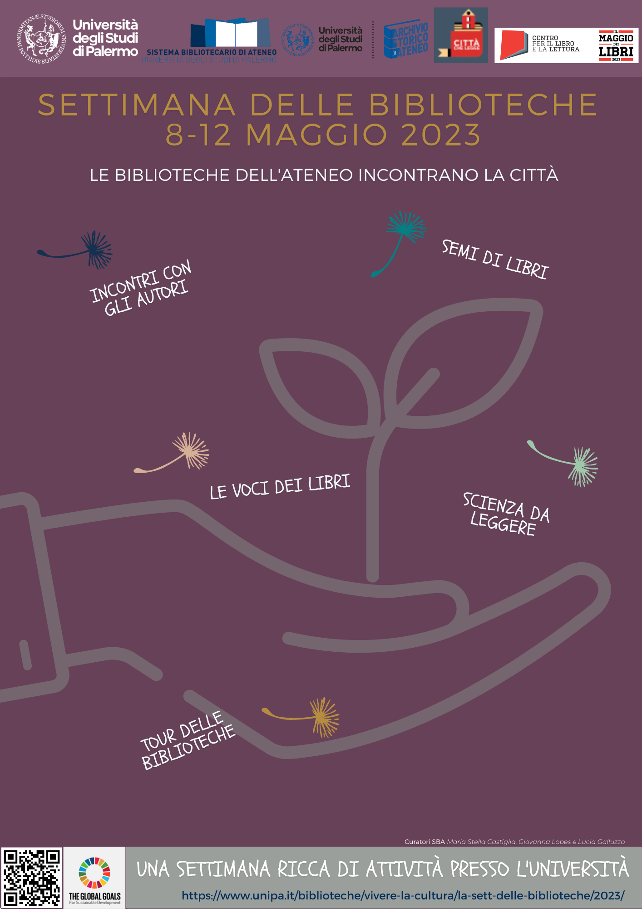
SBA - UNIVERSITY LIBRARY SYSTEM initiatives
https://www.unipa.it/biblioteche/en/conosci-il-nostro-lavoro/benvenuto/
THE VOICE OF BOOKS=> a cycle of reading meetings.
The researchers narrate the research in the libraries, through the “voice of a book”, chosen among those, which have marked and inspired, in some way, their scientific path, enhancing the power that reading has to connect the material and the imaginary, the particular and the universal, the individual and the political.
TRAINING FOR RESEARCHERS
Library staff offers orientation, information and training activities for users in order to improve awareness regarding open access, copyright, data management, reference support. Several times the staff has participated in information and training events for PhD students, also as part of activities related to HR excellence in research.
A BOOK AS MY PRESENT / BOOK SEEDS
Reading education events, open to citizens, for university and school to dialogue: teachers and students, coming from the university and from city schools of all levels, sharing a passion for reading and discussing about scientific arguments.
LIBRARY WEEK
Since 2018, UniPa libraries have organized the Library Week, an event dedicated to the promotion and enhancement of the documentary heritage through the organization, in all the University libraries, of exhibitions, shows, events and seminars open to citizens.

Slide 14
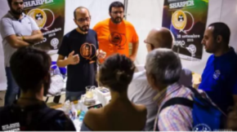


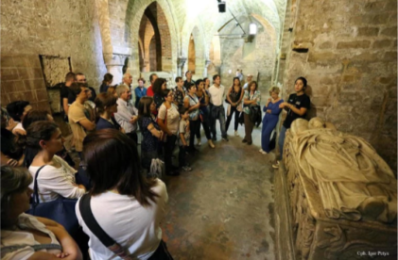
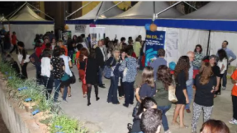
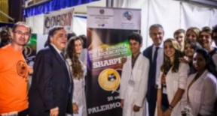
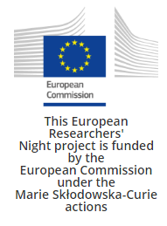
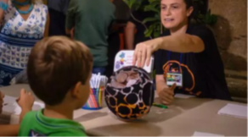

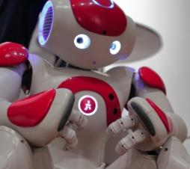
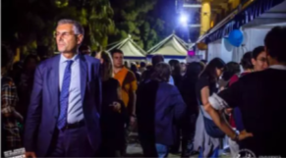
This event is the best way to discover the most beautiful treasures of the island allowing you to get in some places that are usually closed to the public and paying much less than usual, with tour guides who are mainly students, young graduates, practitioners.
https://leviedeitesori.com/

Slide 15
OUR STRATEGY FOR RESEARCH AND INTERNATIONALIZATION
Statute Art.3:
“The University considers the international dimension of teaching and research a priority and undertakes to take all measures to pursue it and is inspired by the European Charter for Researchers and the Code of Conduct for the recruitment of Researchers”
“The University supports and encourages the transfer and enhancement of knowledge, the promotion and protection of health, cultural and environmental heritage as well as the production of goods and services for the benefit of the community”
“The University promotes, as part of the third mission, the dissemination of knowledge and culture, as well as dialogue with the actors of the world of work and civil society, in order to trigger virtuous circles for civil, social and economic of the territory”.

Slide 16
MEMBERSHIPS
8 Research consortia (without equity share, such as: ARCA-University business incubator, CORERAS-Consorzio Regionale per la ricerca applicata e la sperimentazione, CoRiBia - Consorzio di Ricerca sul Rischio Biologico in Agricoltura, CORISSIA – Consorzio di ricerca per lo sviluppo di sistemi innovativi agroambientali, SIRIO research information system managed -Ministry for University and Research)
21 National Interuniversity consortia, with equity participation (Alma Laurea, CINECA)
19 Associations (APRE – Agenzia per la Promozione della Ricerca Europea, CODAU – Convegno dei Direttori Generali delle Amministrazioni Universitarie, CRUI Conferenza dei Rettori delle Università Italiane, C.R.U.S.-Comitato Regionale delle Università Siciliane, CUIA, NETVAL - Network per la Valorizzazione della Ricerca, PNI Cube – Associazione Italiana Incubatori Universitari)
3 National networks APENET (public engagement), R.U.S, SDSN (sustainable development)
14 Foundations
6 Limited liability consortium companies (such as the technological districts
21 Interdepartmental and Interuniversity Research Centres

Slide 17
The Implementation of our Eu/INTERNATIONAL funding strategy
The 16 Departments of UNIPA are decentralized structures, organized according to different scientific disciplinary domains, in charge for teaching, research and technology transfer activities under their domain. The Department benefit from a status of administrative and managerial autonomy.
At the central administration level, the governance in charge for decision-making on the EU funding strategy includes:
the Rector, the Rector’s Delegates, the University Board of Directors, the Academic Senate, the Managing Director, the Scientific Council, the Bioethics Committee, the Evaluation Board, the Quality Assessment Board.
At the operation level, the main offices in charge for the implementation of EU funding strategy are the Research and Technology Transfer Area and the Third Stream and International Relationships Area.

Slide 18
The ORGANIZATION OF RESEARCH AND TECHNOLOGY AREA
HEAD OF RESEARCH AND TECHNOLOGY TRANSFER AREA
UNIT
Secretariat and administrative support
SECTOR
Technology transfer and business creation centre
SECTOR
Research assessment and record
SECTOR
PhDs and research contracts
SECTOR
Strategic research policies
SECTOR
Support to project design and set-up
SECTOR
Project reporting
UNIT Business incubation and acceleration
UNIT Support to Ministry evaluation
UNIT
Phd courses
UNIT
Post-graduate research grants
UNIT Research strategies, interdept and interuniversity centres
UNIT Regional and national project design
UNIT National and regional funded project reporting
UNIT Patents, Spin-off and IP exploitation
UNIT Research Repository
UNIT
PhD contracts, agreements
co-tutorship
UNIT
Research fellowships
UNIT Promotion of funding opportunities and research event organization
UNIT EU, joint, cross-border, international project design
UNIT EU, bilateral, cross-border, internat. project reporting
UNIT Monitoring and development of research labs and infrastructures

Slide 19
The ORGANIZATION OF Third Stream and International Relationships Area
HEAD OF THIRD STREAM AND INTERNATIONAL RELATIONS
UNIT
Secretariat and administrative support
SECTOR
Inclusion, equal opportunities and gender policies
SECTOR
Strategic policies for the third stream
SECTOR
Business relations and placements
SECTOR
Third stream communication strategies
SECTOR
Internationalization
UNIT
Gender policies and equal opportunities
UNIT
Third stream strategies
UNIT
Company placements and career service
UNIT
Social web and portal
UNIT
Cooperation and Networks
UNIT
Projects and funding
UNIT
Disability
UNIT
Third stream evaluation and quality systems
UNIT
Contracts with public and private bodies
UNIT
Cultural initiatives, science outreach
Clab, O.I., merchandising
UNIT
Incoming Students
UNIT
Promotion and communication of international training offer
UNIT
Neurodiversity
UNIT
Affiliated entities
UNIT
Outgoing Students

