Slide 1
Centro di riferimento regionale per le Malattie Rare Neuromuscolari
UOSD Neurofisiopatologia
AUOP P. Giaccone
Palermo
Responsabile: Prof. Filippo Brighina

Slide 2
Chi siamo?
Ambulatorio Diagnosi e Cura delle Malattie Neuromuscolari Rare
Telefoni: 0916554780 Via del Vespro ,143 Padiglione 26/a (Padiglione Medicina del Lavoro piano rialzato)
neuromuscolarepalermo@gmail.com

Slide 3
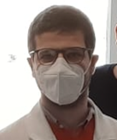
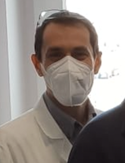
Medici del Centro
Prof. Filippo Brighina
Dott. Vincenzo Di Stefano
Dott. A. Lupica
Dott. A. Gagliardo

Slide 4
Riconoscimento dal 2014
Ultimo accreditamento: Gazzetta ufficiale Venerdì, 7 gennaio 2022

Slide 5
Di cosa ci occupiamo?
Patologia | n. pazienti
Miastenia gravis | 150
Distrofie muscolari (Duchenne, Steinert, Pompe, FSHD, OPMD, mitocondriali) | 70
Charcot-Marie-Tooth | 65
Neuropatie disimmuni (GBS, CIDP) | 55
Amiloidosi ereditaria TTR | 40
Paraparesi spastica ereditaria | 30
Atassie spinocerebellari | 12
Atrofia muscolare spinale | 10
Corea di Huntington | 6
Emicrania emiplegica | 5

Slide 6
Miastenia gravis
Gambino CM, et al. The role of serum free light chain as biomarker of Myasthenia Gravis. Clin Chim Acta. 2022 Jan 17;528:29-33. doi: 10.1016/j.cca.2022.01.004. Epub ahead of print. PMID: 35051425.
Gambino CM, et al. Comparative Analysis of BIOCHIP Mosaic-Based Indirect Immunofluorescence with Enzyme-Linked Immunosorbent Assay for Diagnosing Myasthenia Gravis. Diagnostics (Basel). 2021 Nov 13;11(11):2098. doi: 10.3390/diagnostics11112098. PMID: 34829445; PMCID: PMC8619605.
Di Stefano V, et al. Rituximab in AChR subtype of myasthenia gravis: systematic review. J Neurol Neurosurg Psychiatry. 2020 Apr;91(4):392-395. doi: 10.1136/jnnp-2019-322606. Epub 2020 Feb 25. PMID: 32098874.
Lupica A, Di Stefano V, Iacono S, Pignolo A, Quartana M, Gagliardo A, Fierro B, Brighina F. Impact of COVID-19 in AChR Myasthenia Gravis and the Safety of Vaccines: Data from an Italian Cohort. Neurol Int. 2022 Apr 27;14(2):406-416. doi: 10.3390/neurolint14020033. PMID: 35645352; PMCID: PMC9149833.

Slide 7
Malattie del nervo periferico
Cosentino G, et al. Expression pattern of matrix metalloproteinases-2 and -9 and their tissue inhibitors in patients with chronic inflammatory demyelinating polyneuropathy. Neurol Sci. 2021 Oct;42(10):4297-4300. doi: 10.1007/s10072-021-05314-y. Epub 2021 May 14. PMID: 33988800.
Di Stefano V, et al. Significant reduction of physical activity in patients with neuromuscular disease during COVID-19 pandemic: the long-term consequences of quarantine. J Neurol. 2021 Jan;268(1):20-26. doi: 10.1007/s00415-020-10064-6. Epub 2020 Jul 13. PMID: 32661716; PMCID: PMC7356123.
Di Stefano V, et al. Median-to-Ulnar Nerve Communication in Carpal Tunnel Syndrome: An Electrophysiological Study. Neurol Int. 2021 Jul 12;13(3):304-314. doi: 10.3390/neurolint13030031. PMID: 34287351; PMCID: PMC8293426.
Liberatore G, De Lorenzo A, Giannotta C, Manganelli F, Filosto M, Cosentino G, Cocito D, Briani C, Cortese A, Fazio R, Lauria G, Clerici AM, Rosso T, Marfia GA, Antonini G, Cavaletti G, Carpo M, Doneddu PE, Spina E, Cotti Piccinelli S, Peci E, Querol L, Nobile-Orazio E. Frequency and clinical correlates of anti-nerve antibodies in a large population of CIDP patients included in the Italian database. Neurol Sci. 2022 Jun;43(6):3939-3947. doi: 10.1007/s10072-021-05811-0. Epub 2022 Jan 20. PMID: 35048233.
Spina E, Doneddu PE, Liberatore G, Cocito D, Fazio R, Briani C, Filosto M, Benedetti L, Antonini G, Cosentino G, Jann S, Mazzeo A, Cortese A, Marfia GA, Clerici AM, Siciliano G, Carpo M, Luigetti M, Lauria G, Rosso T, Cavaletti G, Peci E, Tronci S, Ruiz M, Piccinelli SC, Schenone A, Leonardi L, Gentile L, Piccolo L, Mataluni G, Santoro L, Nobile-Orazio E, Manganelli F; Italian CIDP Database Study Group. Prolonged distal motor latency of median nerve does not improve diagnostic accuracy for CIDP. J Neurol. 2022 Feb;269(2):907-912. doi: 10.1007/s00415-021-10672-w. Epub 2021 Jun 26. PMID: 34173874; PMCID: PMC8782796.
Spina E, Doneddu PE, Liberatore G, Cocito D, Fazio R, Briani C, Filosto M, Benedetti L, Antonini G, Cosentino G, Jann S, Mazzeo A, Cortese A, Marfia GA, Clerici AM, Siciliano G, Carpo M, Luigetti M, Lauria G, Rosso T, Cavaletti G, Peci E, Tronci S, Ruiz M, Piccinelli SC, Schenone A, Leonardi L, Gentile L, Piccolo L, Mataluni G, Santoro L, Nobile-Orazio E, Manganelli F; on the behalf of the Italian CIDP Database Study Group. The neurophysiological lesson from the Italian CIDP database. Neurol Sci. 2022 Jan;43(1):573-582. doi: 10.1007/s10072-021-05321-z. Epub 2021 May 21. PMID: 34021439; PMCID: PMC8724146.
Doneddu PE, Cocito D, Manganelli F, Fazio R, Briani C, Filosto M, Benedetti L, Bianchi E, Jann S, Mazzeo A, Antonini G, Cosentino G, Marfia GA, Cortese A, Clerici AM, Carpo M, Schenone A, Siciliano G, Luigetti M, Lauria G, Rosso T, Cavaletti G, Beghi E, Liberatore G, Santoro L, Spina E, Peci E, Tronci S, Ruiz M, Cotti Piccinelli S, Verrengia EP, Gentile L, Leonardi L, Mataluni G, Piccolo L, Nobile-Orazio E; Italian CIDP Database study group. Frequency of diabetes and other comorbidities in chronic inflammatory demyelinating polyradiculoneuropathy and their impact on clinical presentation and response to therapy. J Neurol Neurosurg Psychiatry. 2020 Oct;91(10):1092-1099. doi: 10.1136/jnnp-2020-323615. Epub 2020 Aug 31. PMID: 32868387.

Slide 8
Amiloidosi ereditaria da trasntiretina
Russo M, et al. Use of Drugs for ATTRv Amyloidosis in the Real World: How Therapy Is Changing Survival in a Non-Endemic Area. Brain Sci. 2021 Apr 27;11(5):545. doi: 10.3390/brainsci11050545. PMID: 33925301; PMCID: PMC8146901.
Di Stefano V, Fava A, Gentile L, Guaraldi P, Leonardi L, Poli L, Tagliapietra M, Vastola M, Fanara S, Ferrero B, Giorgi M, Perfetto F, Russo M, Russo D. Italian Real-Life Experience of Patients with Hereditary Transthyretin Amyloidosis Treated with Patisiran. Pharmgenomics Pers Med. 2022 May 12;15:499-514. doi: 10.2147/PGPM.S359851. PMID: 35592550; PMCID: PMC9113125.
Di Lisi D, Di Caccamo L, Damerino G, Portelli MC, Comparato F, Di Stefano V, Brighina F, Corrado E, Galassi AR, Novo G. Effectiveness and Safety of Oral Anticoagulants in Cardiac Amyloidosis: Lights and Shadows. Curr Probl Cardiol. 2022 Mar 25:101188. doi: 10.1016/j.cpcardiol.2022.101188. Epub ahead of print. PMID: 35346721.
Di Stefano V, Thomas E, Giustino V, Iacono S, Torrente A, Pillitteri G, Gagliardo A, Lupica A, Palma A, Battaglia G, Brighina F. Motor Conduction Studies and Handgrip in Hereditary TTR Amyloidosis: Simple Tools to Evaluate the Upper Limbs. Front Neurol. 2022 Feb 28;13:835812. doi: 10.3389/fneur.2022.835812. PMID: 35295833; PMCID: PMC8918493.

Slide 9
Emicrania emiplegica, Stiff-person syndrome, Hirayama, Glicogenosi
Nardello R, et al. Two distinct phenotypes, hemiplegic migraine and episodic Ataxia type 2, caused by a novel common CACNA1A variant. BMC Neurol. 2020 Apr 26;20(1):155. doi: 10.1186/s12883-020-01704-5. PMID: 32336275; PMCID: PMC7183684.
Di Stefano V, et al. Diagnostic and therapeutic aspects of hemiplegic migraine. J Neurol Neurosurg Psychiatry. 2020 Jul;91(7):764-771. doi: 10.1136/jnnp-2020-322850. Epub 2020 May 19. PMID: 32430436; PMCID: PMC7361005.
Nardello R, Plicato G, Mangano GD, Gennaro E, Mangano S, Brighina F, Raieli V, Fontana A. Two distinct phenotypes, hemiplegic migraine and episodic Ataxia type 2, caused by a novel common CACNA1A variant. BMC Neurol. 2020 Apr 26;20(1):155. doi: 10.1186/s12883-020-01704-5. PMID: 32336275; PMCID: PMC7183684.
Cosentino G, et al. Intranasal midazolam for treating acute respiratory crises in a woman with stiff person syndrome. Neurol Neuroimmunol Neuroinflamm. 2020 Apr 1;7(4):e715. doi: 10.1212/NXI.0000000000000715. PMID: 32238523; PMCID: PMC7176251.
Iacono S, Di Stefano V, Gagliardo A, Cannella R, Virzì V, Pagano S, Lupica A, Romano M, Brighina F. Hirayama disease: Nosological classification and neuroimaging clues for diagnosis. J Neuroimaging. 2022 Apr 8. doi: 10.1111/jon.12995. Epub ahead of print. PMID: 35394668.
Lupica A, et al. Inherited Neuromuscular Disorders: Which Role for Serum Biomarkers? Brain Sci. 2021 Mar 21;11(3):398. doi: 10.3390/brainsci11030398. PMID: 33801069; PMCID: PMC8004068.
Iacono S, Lupica A, Di Stefano V, Borgione E, Brighina F. A novel compound heterozygous mutation in PYGM gene associated with McArdle's disease. Acta Myol. 2022 Mar 31;41(1):37-40. doi: 10.36185/2532-1900-067. PMID: 35465342; PMCID: PMC9004334.

Slide 10
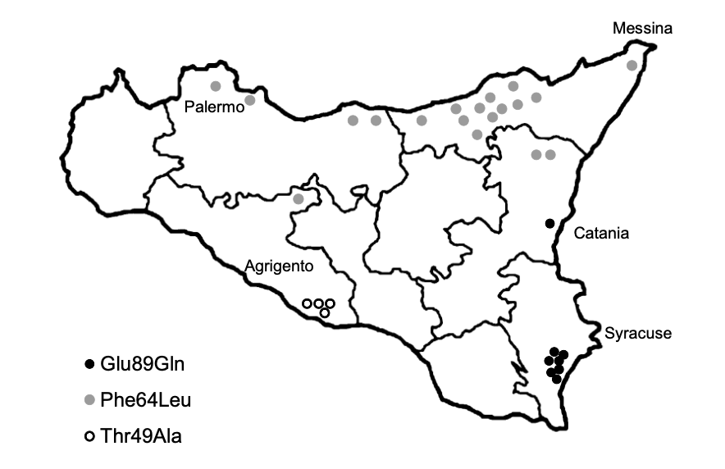
Attività di screening genetico
Nuove diagnosi da gennaio 2020

Slide 11
Associazioni pazienti
CIDP onlus
ACMT Rete
Famiglie SMA
Associazione Malattie Autoimmuni Rare (AMAR)
fAMY
AISA

Slide 12
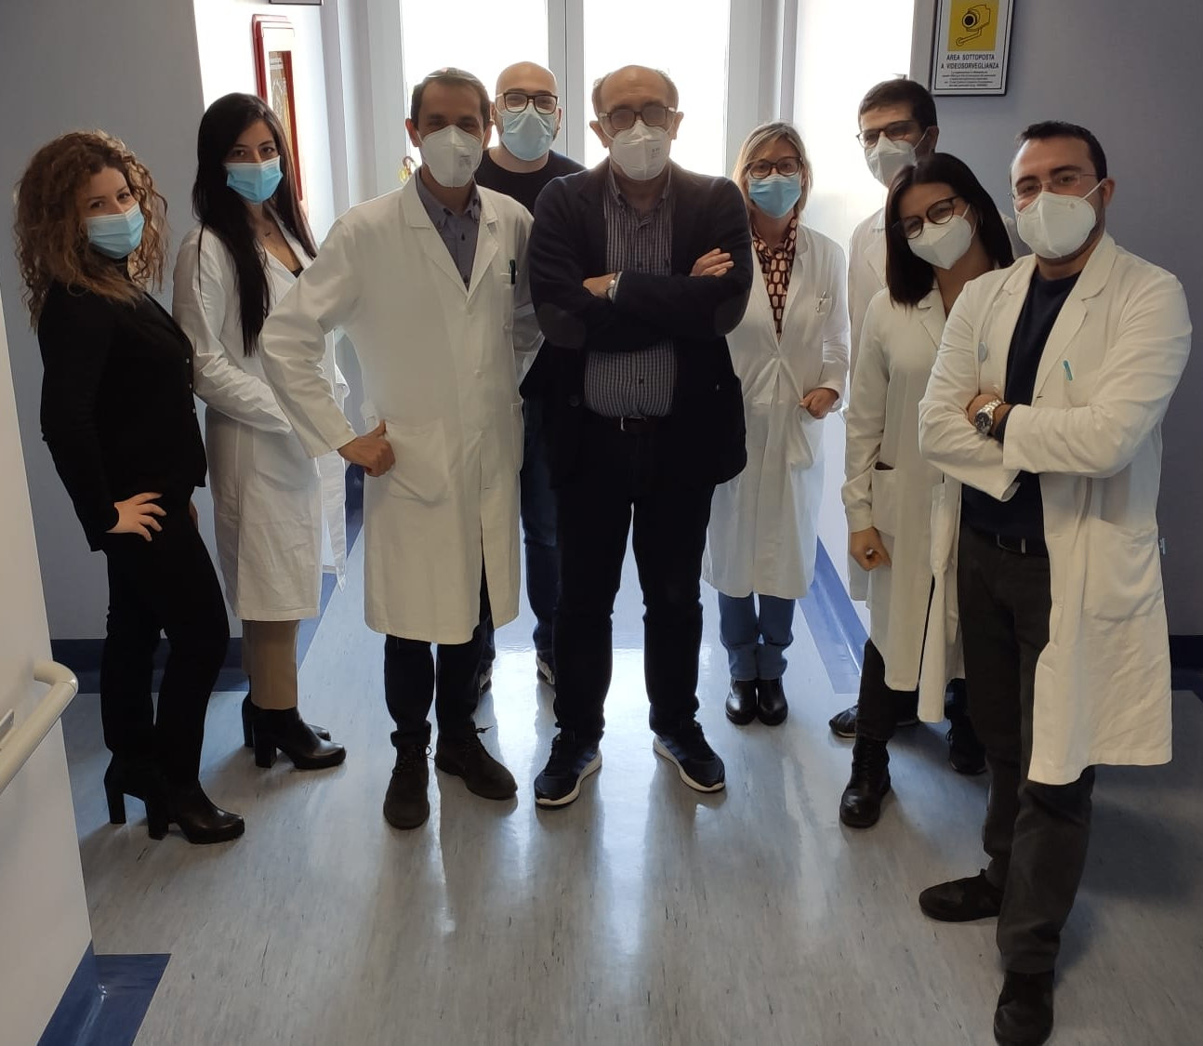
Grazie per l’attenzione!
UOSD Neurofisiopatologia Policlinico di Palermo
Scriveteci:
neuromuscolarepalermo@gmail.com
Oppure seguiteci sulla nostra pagina Facebook:
“Diagnosi e cura delle malattie neuromuscolari rare”

