Slide 1
Malattia di von Willebrand (vWD)
Emofilia A, Emofilia B, deficit rari della coagulazione
Piastrinopenia Immune (ITP)
Piastrinopenie patie ereditarie
Centro di Riferimento regionale per le coagulopatie dell’adulto e del bambino
Porpora Trombotica Trombocitopenica (PTT)
Tromboembolismo
venoso (TEV)
Emoglobinuria Parossistica
Notturna (EPN)
Trombofilia genetica e funzionale (deficit anticoagulanti)
Prof. Sergio Siragusa
Prof. Mariasanta Napolitano
S. da Anticorpi anti-fosfolipidi

Slide 2
Corelab Settore Emostasi e Trombosi
Prof.M.Ciaccio
Dott. Bonura
Approccio Multidisicplinare nella gestione dei deficit emorragici congeniti
Odontoiatria
Dott. N.Mauceri
Fisiatria
Prof. L. Mauro
Dott. D. Scaturro
Gastroenterologia Prof. V.Di Marco
Supporto psicologico
Dott. M.F. Mansueto
Chirurgia generale
Prof. G.Cocorullo

Slide 3
Accessi U.O. per prime visite ematologiche
Sosp. Linfoma 13,8%
Mieloproliferative 6,0%
38
43
Alterazione GB 13,8%
99
720 pz
323
Coagulopatie 44,9%
46
Varie 6,4%
87
67
Anemie 12,1%
Piastrinopenie 9,9%
Periodo: dal 01/06/2021 al 01/06/2022 - 720 pazienti
Notes:
References
Hartmann J et al. Am J Hematol 2016;91(12):1252–1260
Bertamino M et al. J Clin Med 2017;6(5):pii: E54
Arruda VR et al. F1000Res 2018;7: pii: F1000 Faculty Rev-489
Manco-Johnson MJ et al. N Engl J Med 2007;357:535–44
Gringeri A et al. J Thromb Haemost 2011;9:700–10
Fischer K et al. Haemophilia 2011;17(3):433–438
Collins PW et al. Haemophilia 2012;18(s4):131–135
Olivieri M et al. Haemophilia 2012;18:369–74
Oldenburg J. Blood 2015;125(13):2038-2044
von Mackensen S et al. Haemophilia 2017;23(4):566-574
Soucie M et al. JTH 2015;13(Suppl.2);157. Presented at ISTH 2015. OR 162
Tagliaferri A et al. Thromb Haemost 2015;114:35-45
Oldenburg J et al. Haemophilia 2015;21:171-9
Jiménez-Yuste V et al. Blood Transfus 2014;12:314-319
Srivastava A et al. Haemophilia 2012;1–47
Mahdi A et al. Brit J Haematol 2015;169:768–776
Kruse-Jarres R et al. Blood 2017;130:89
Santagostino E et al. Abstract 2360 presented at ASH 2017

Slide 4
Trombosi
Petecchie
D-Dimero elevato
Poliabortività
Couagulopatia
Allungamento PT/PTT
Alterazione della couagulazione
Ematomi, Ecchimosi
Trombofilia
Lupus Anticoagulante
Edemi
Tromboflebite
Tromboembolismo

Slide 5
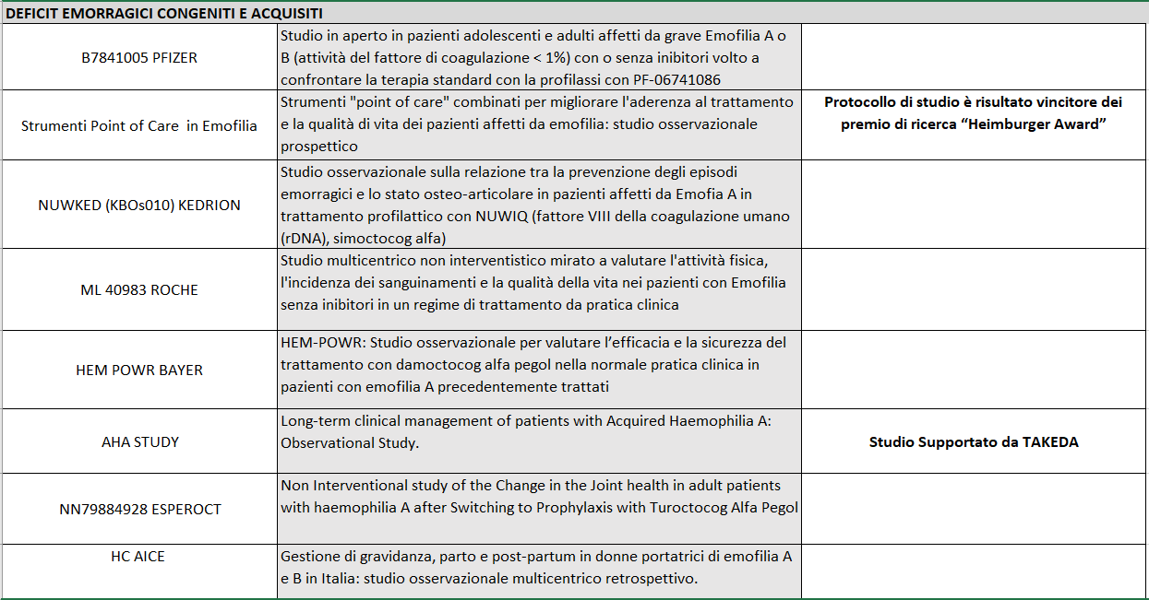
Studi Clinici Deficit Emorragici Congeniti e Acquisiti-Trombocitopenia

Slide 6
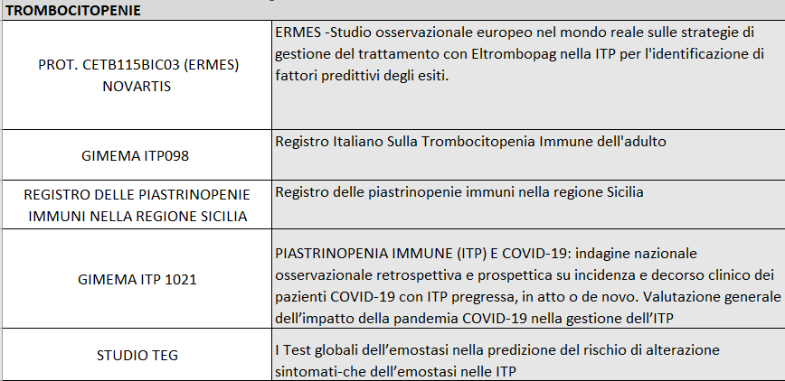
Studi Clinici Deficit Emorragici Congeniti e Acquisiti-Trombocitopenie

Slide 7
Studi Clinici Patologie Trombotico-emorragiche
Membro del Panel di esperti per la stesura delle Linee guida SIE relative alla gestione del paziente adulto affetto da Trombocitopenia immune https://www.siematologia.it/linee-guida-sie.html
Coordinatore del Panel di esperti per la stesura delle Linee guida SIE del Tromboembolismo venoso nelle neoplasie Ematologiche(Linfomi, Mieloma Multiplo, Leucemie Acute) https://www.siematologia.it/linee-guida-sie.html .

Slide 8
Pubblicazioni (1)
Biasoli C, Baldacci E, Coppola A, De Cristofaro R, Di Minno MND, Lassandro G, Linari S, Mancuso ME, Napolitano M, Pasta G, Rocino A; MEMO Study Group (Appendix I). Promoting physical activity in people with haemophilia: the MEMO (Movement for persons with haEMOphilia) expert consensus project. Blood Transfus. 2022 Jan;20(1):66-77. doi: 10.2450/2021.0138-20. Epub 2021 Oct 15. PMID: 34694222.
Di Minno MND, Napolitano M, Giuffrida AC, Baldacci E, Carulli C, Boccalandro E, Bruno C, Forneris E, Ricca I, Passeri W, Martinelli M, Rivolta GF, Solimeno LP, Martinoli C, Rocino A, Pasta G; Italian Association of Haemophilia Centres Musculoskeletal Working Group. Diagnosis and treatment of chronic synovitis in patients with haemophilia: consensus statements from the Italian Association of Haemophilia Centres. Br J Haematol. 2021 Dec 19. doi: 10.1111/bjh.17919. Epub ahead of print. PMID: 34923621.
Franchini M, Coppola A, Santoro C, De Cristofaro R, Barillari G, Giordano P, Gresele P, Lassandro G, Napolitano M, Lucchini G, Luciani M, Ferretti A, Baldacci E, Riccardi F, Santoro RC, Pasca S, Zanon E, Tagliaferri A. ABO Blood Group and Inhibitor Risk in Severe Hemophilia A Patients: A Study from the Italian Association of Hemophilia Centers. Semin Thromb Hemost. 2021 Feb;47(1):84-89. doi: 10.1055/s-0040-1718870.
Napolitano M, Olsen AA, Nøhr AM, Eichler H. Recombinant FVIII Products (Turoctocog Alfa and Turoctocog Alfa Pegol) Stable Up to 40°C. J Blood Med. 2021 Jan 25;12:9-20. doi: 10.2147/JBM.S284060.
Raso S, Napolitano M, Arrigo G, Reale F, Lucchesi A, Silimbani P, Maggio A, Calvaruso G, Consoli U, Mannina D, Giordano G, Santoro M, Accurso V, Siragusa S. Antimicrobial prophylaxis in patients with immune thrombocytopenia treated with rituximab: a retrospective multicenter analysis. Ann Hematol. 2021 Mar;100(3):653-659. doi: 10.1007/s00277-021-04438-7.
Siragusa S, Napolitano M. « Mimicking Factor VIII activity to control bleeding in acquired haemophilia: a promising perspective ». Blood (2021) 137 (3):294–295.
Napolitano M, Mansueto MF, Sirocchi D, Contrino AD, Raso S, Siragusa S. Emotions and opinions of adult patients with haemophilia during the COVID-19 (coronavirus disease 2019) pandemic caused by SARS-CoV-2:a monocentric survey. Patient Preference and Adherence 2020:14 1145–1147

Slide 9
Pubblicazioni (2)
Raso S,Napolitano M, Mansueto F, Mercurio P, Cocorullo G, Santoro M, Accurso V, Mancuso S, Siragusa S. Coexistence of Von Willebrand Disease and Gastrointestinal Stromal Tumor (G.I.S.T): Case Report of a Rare and Challenge Association.Transfus Apher Sci. 2020 May 11;102805
Napolitano M, Nøhr AM.The Effect of Fluctuating Temperature on the Stability of Turoctocog Alfa for Hemophilia A. Drugs R D. 2019 Dec;19(4):381-390
Napolitano M, Mancuso S, Raso S, LoCoco L, Arfò PS, De Francisci G, Dieli F, Caccamo N, Reina A, Dolce A, Agliastro R, Siragusa S.Buffy coat-derived platelets cryopreserved using a new method: Results from a pivotal clinical trial on thrombocytopenic patients with acute leukaemia.Transfus Apher Sci. 2019 Dec;58(6):102666
Gresele P, Orsini S, Noris P, Falcinelli E, Alessi MC, Bury L, Borhany M, Santoro C, Glembotsky AC, Cid AR, Tosetto A, De Candia E, Fontana P, Guglielmini G, Pecci A; BAT-VAL study investigators.Validation of the ISTH/SSC bleeding assessment tool for inherited platelet disorders: A communication from the Platelet Physiology SSC.J Thromb Haemost. 2019 Nov 21. doi: 10.1111/jth.14683
Yu JK, Iorio A, Edginton AN; WAPPS co‐investigators.Using pharmacokinetics for tailoring prophylaxis in people with hemophilia switching between clotting factor products: A scoping review. Res Pract Thromb Haemost. 2019 May 20;3(3):528-541.
Napolitano M, Saccullo G, Marietta M, Carpenedo M, Castaman G, Cerchiara E, Chistolini A, Contino L,De Stefano V, Falanga A,Federici AB, Rossi E,Santoro R, Siragusa S ; Gruppo Italiano Malattie EMatologiche dell’Adulto (GIMEMA) Working Party on Thrombosis and Haemostasis. Platelet cut-off for anticoagulant therapy in thrombocytopenic patients with blood cancer and VTE: an expert consensus. Blood Transfus. 2018 Oct 24:1-10.

