Slide 1
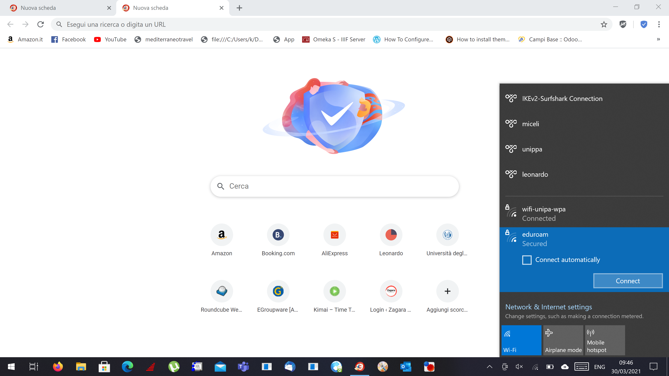

Guide to edoroam wifi connection
Please click on the wifi connection
and choose the eduroam network

Slide 2
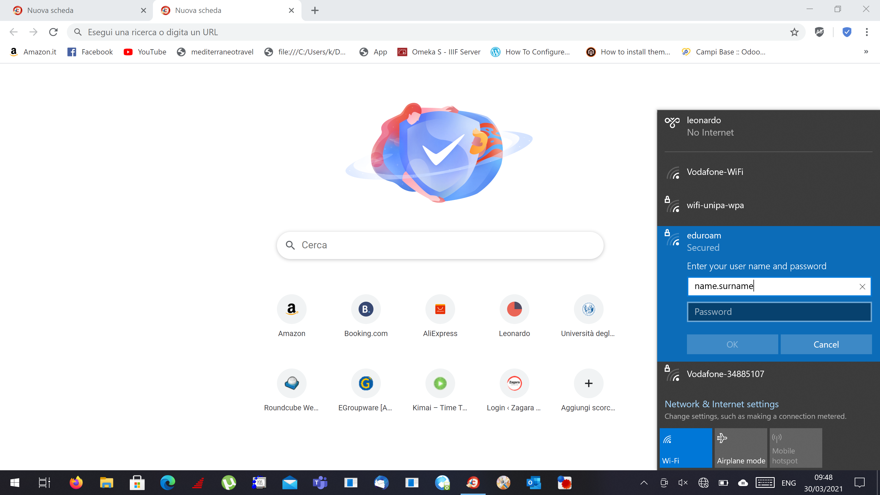
Enter your credentials:
Username ( the correct format is : name.surname )
And password

